Slide 1
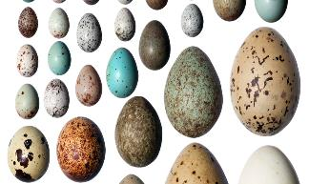
Egg Matching
Visitors’ chance to investigate animal eggs
Activity
Visitors will have seen some replica animal eggs and identified differences in shape, size and colour
Visitors will have used information about animal habitats and behaviours to match up model eggs with the animal to which they belong
Visitors will know that animal eggs are adapted to avoid different threats according to the animals’ habitat
Remember to keep an eye on the model eggs and encourage families/visitors to handle them gently (no squeezing!) Whilst waiting, others can look at animal/habitat photos and challenge them to think what kind of eggs might be laid.
Model eggs
Animal egg fact sheets
Who Am I? cards
Habitat pictures
Visitors take a tray containing 7 fact cards and 7 model eggs. Explain that they need to read the information sheets describing the eggs of the Peregrine Falcon, Magpie, Great Blue Heron, Magellanic Penguin, Spotted Ray, Green Turtle and Crocodile and then try and match the model egg to the animal that laid it. Encourage visitors to describe and discuss the shapes and colours of the eggs and consider how these adaptations help to keep the eggs safe.
Use the “Who Am I?” cards to guess whether or not the animal lays eggs or gives birth to live young. They can also look at habitat pictures and imagine what the eggs of animals living there might look like.

